Slide 1
Predator-Prey Model
Connor Hann, Xiaomeng Jia, Peifan Liu, and Xinyu Wu¹
¹ Physics Department, Duke University

Slide 2
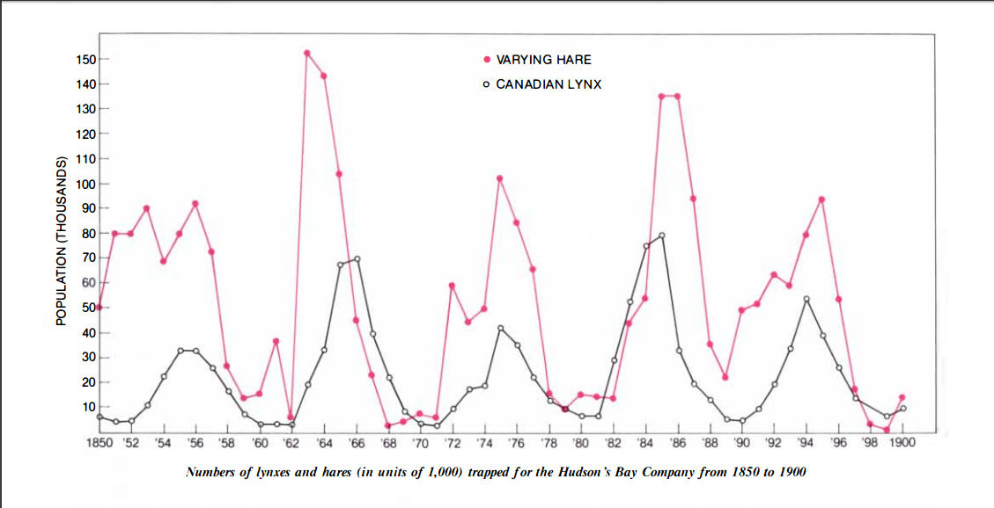
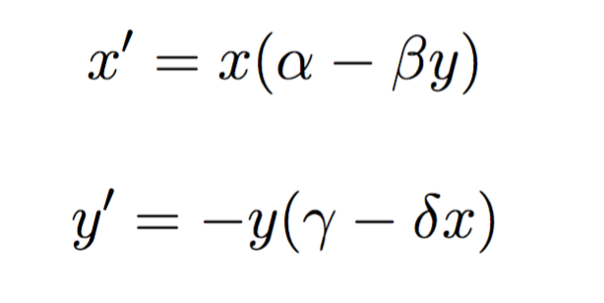
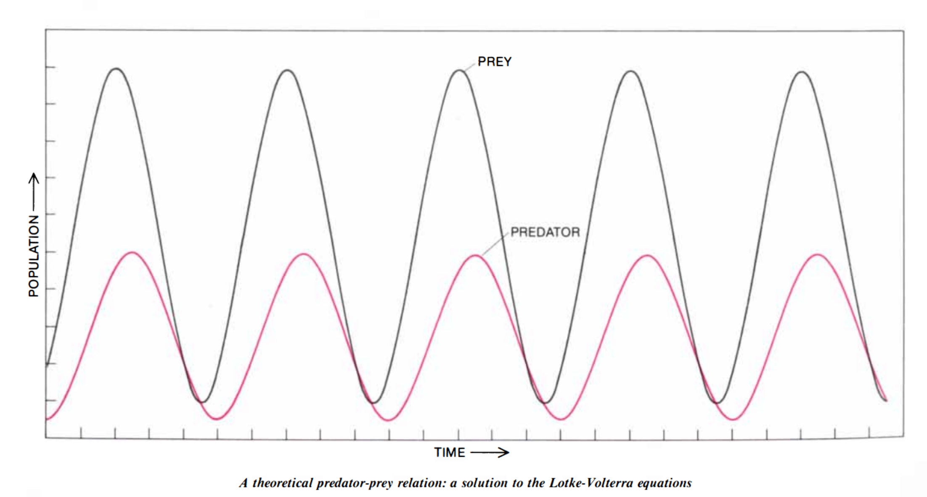
Predator-Prey Models
Lotkka-Voltera Model
Simple models can have strong predictive power!

Slide 3
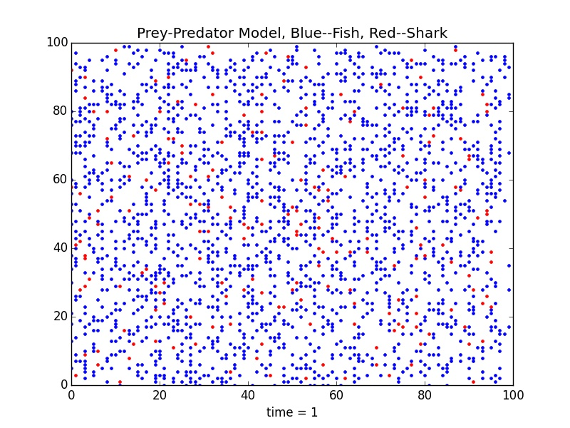
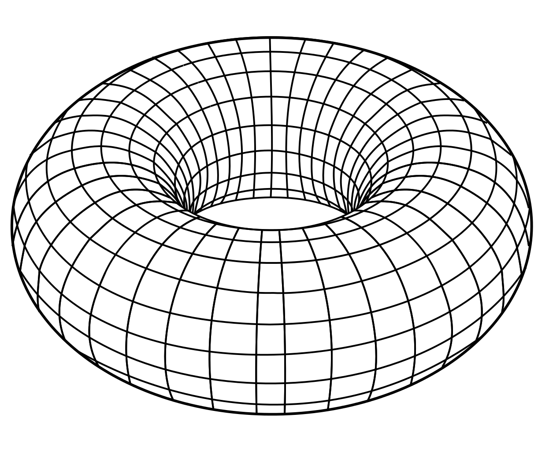
Our Model: Fish and Sharks
Program parameters:
Initial number of fish n0_fish
Initial number of sharks n0_sharks
Time for fish to breed breed_age_fish
Time for sharks to breed breed_age_sharks
Time for sharks to starve starve_time
Two-dimensional periodic N x N grid

Slide 4
Shark and Fish Movement
Lotkka-Voltera Model
Simple models can have strong predictive power!

Slide 5
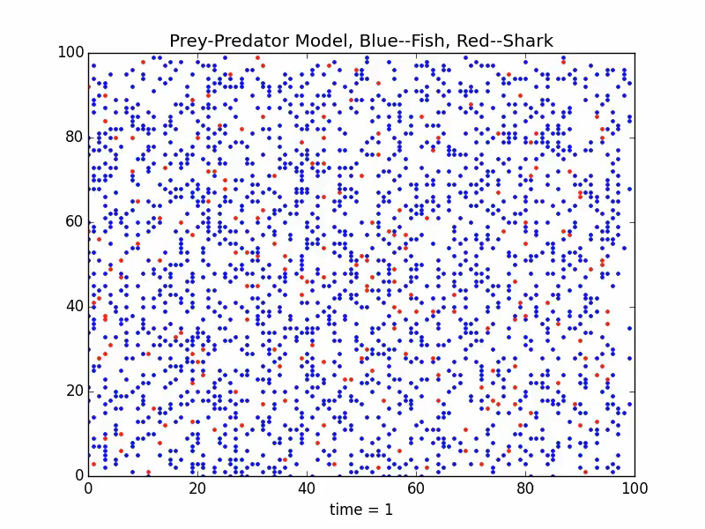
Animation

Slide 6
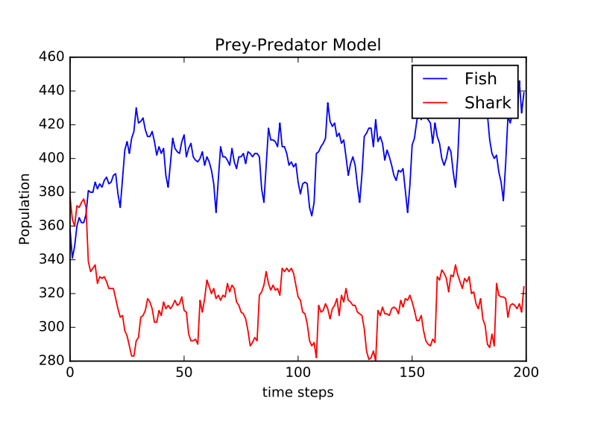
Periodic

Slide 7
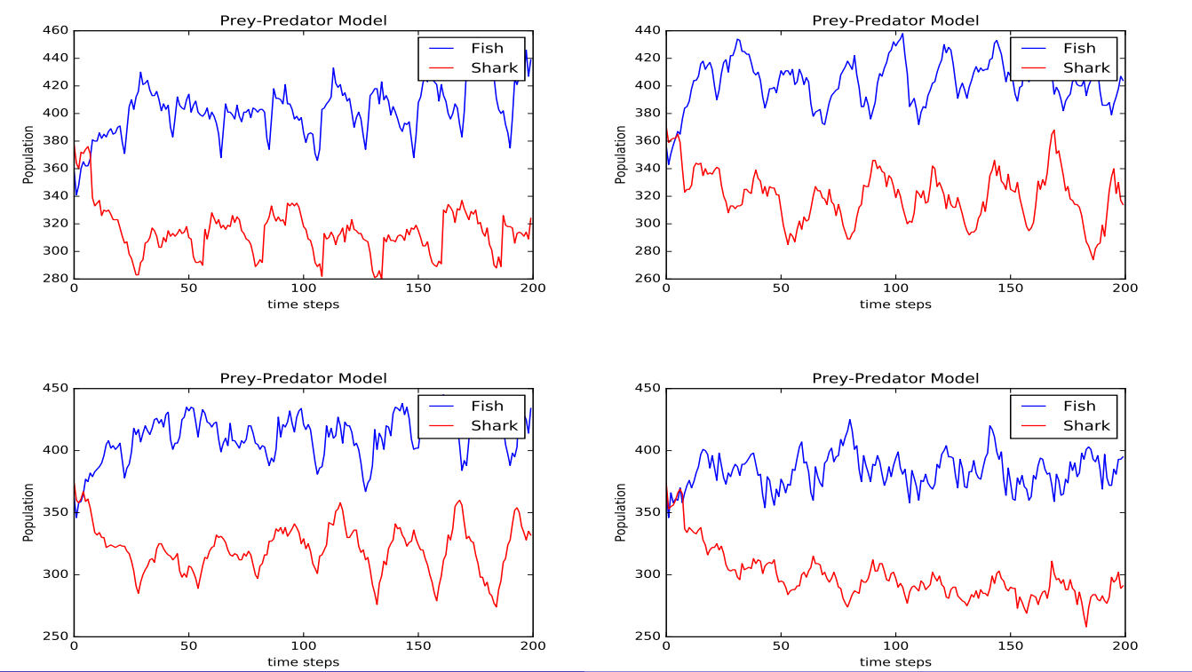
Stochastic
Result is different for each run.

Slide 8
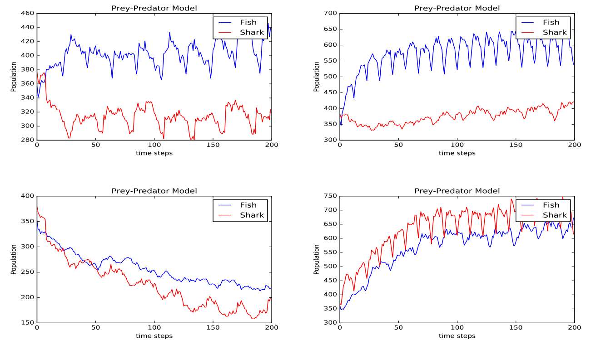
Parameter Sensitive
Breeding age significantly influence oscillation period and amplitude.

Slide 9
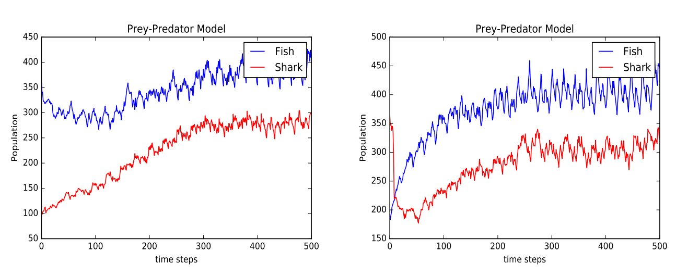
Initial condition insensitive
Goes to certain level after sufficient long time.

Slide 10
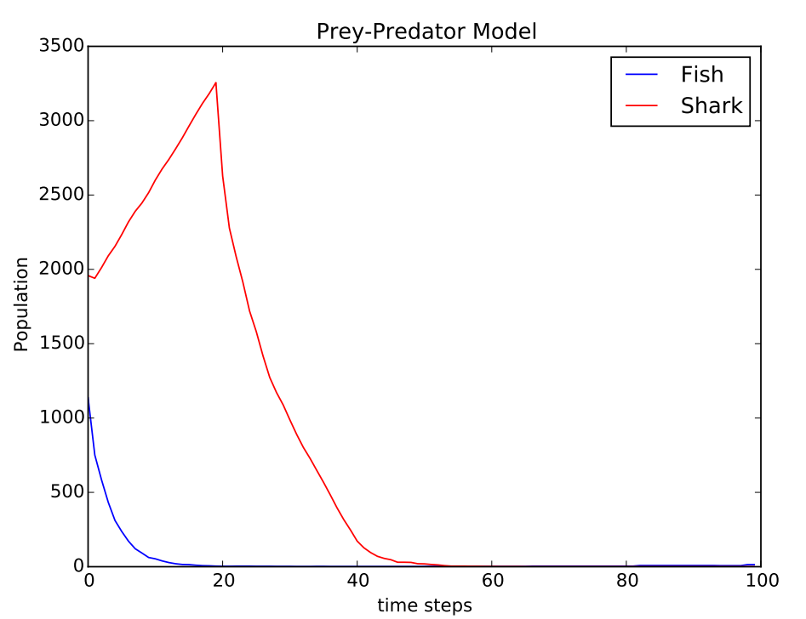
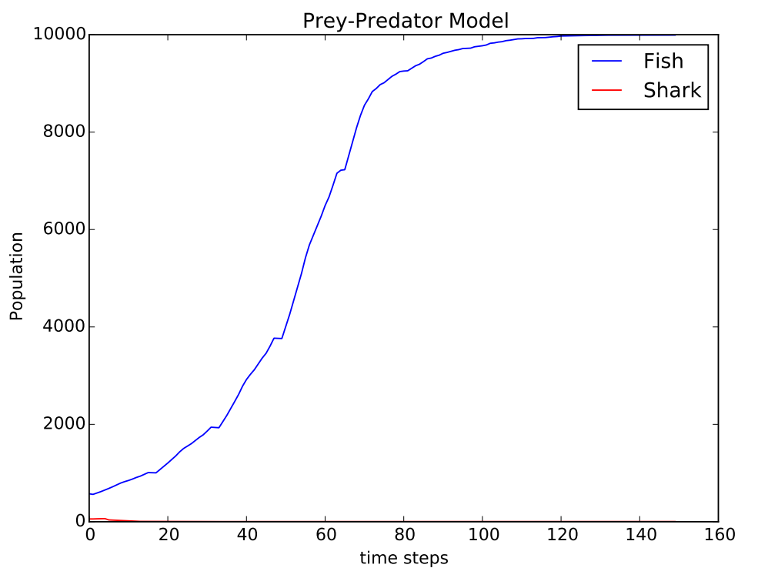
Extinction Happens.
Two kind of extinction can happen!

Slide 11
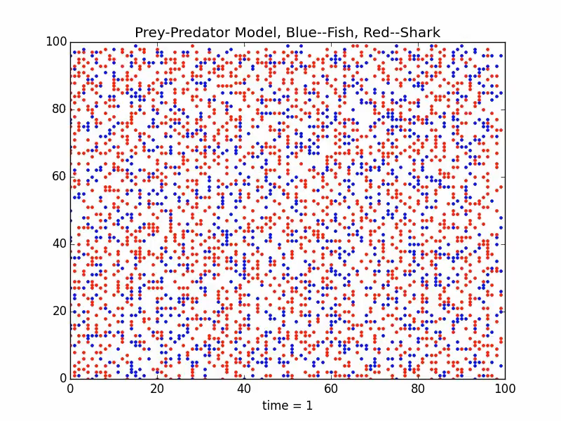
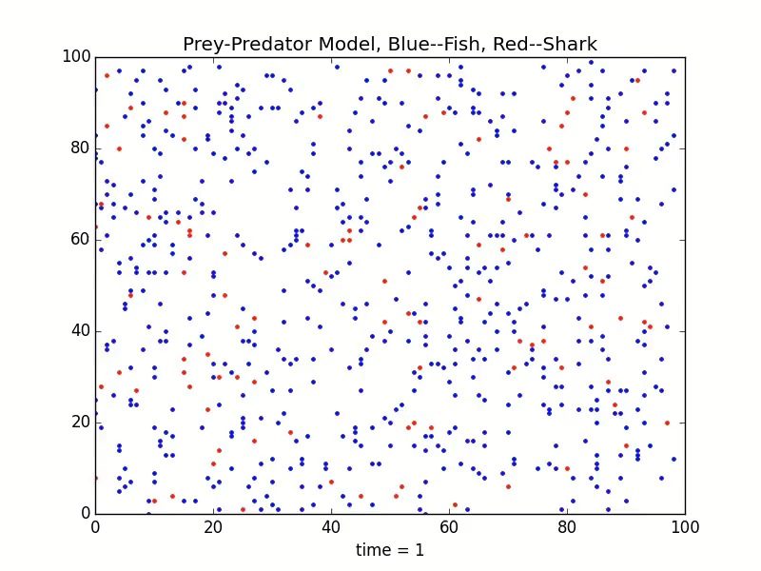
Animation for extinction

Slide 12
Conclusion
The game shows same characteristic with the predator-prey model.
For same parameter, different result can be obtained(stochastic).
Changing parameters can change the result significantly.
Changing initial condition to some extent do not change the level of the overall result.
Extinction can happen so the parameters need to be tuned carefully.

Slide 13

Thank You!

